Slide 1
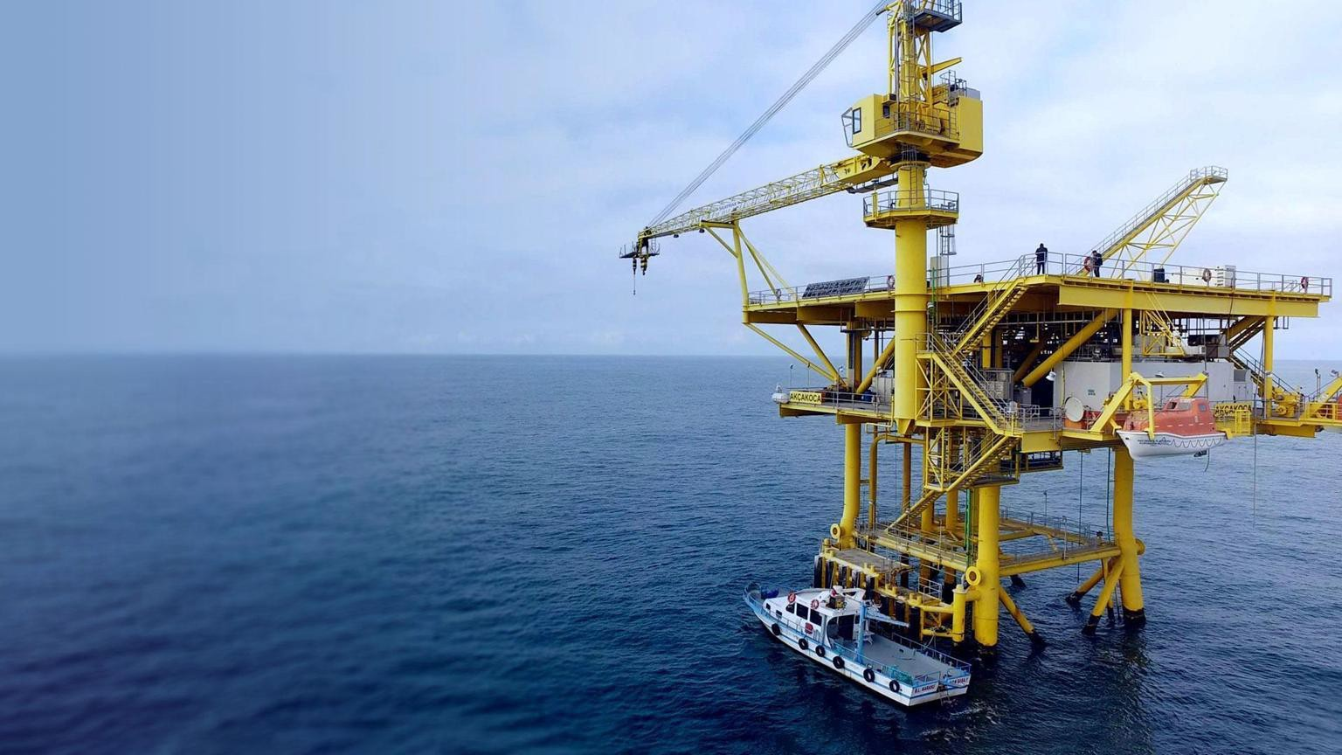

Natural Gas Production in Turkiye
Corporate presentation
January 2026
CSE: TCF | Frankfurt: Z620
| OTC: TRLEF
Trillion Energy Akçakoca Gas Production Platform, SASB Gas Field, Black Sea, Turkiye

Slide 2

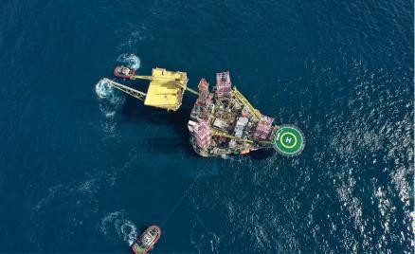
Disclaimers
Since forward-looking information addresses future events and
attempted to identify important factors and risks that could cause actual actions, events or results to differ materially from those described in the forward-looking information, there may be other factors and risks that cause actions, events or results not to be as anticipated, estimated or intended.
Market and Industry Data
Certain market, independent third party and industry data contained in this
Presentation is based upon information from government or other independent industry publications and reports or based on estimates derived from such publications and reports. Government and industry
publications and reports generally indicate that they have obtained their information from sources believed to be reliable, but none of the Company or any of its agents has conducted its own independent verification of such
information. While the Company believes this data to be reliable, market and industry data is subject to variations and cannot be verified with
complete certainty due to limits on the availability and reliability of raw
data, the voluntary nature of the data gathering process and other limitations and uncertainties inherent in any statistical survey. None of the Company or any of its agents has independently verified any of the data from independent third party sources referred to in this Presentation or ascertained the underlying assumptions relied upon by such source.
conditions, by unknown risks Trillion. Actual
its very nature it involves inherent known and and uncertainties which are beyond the control of results could differ materially from those currently
anticipated due to a number of factors and risks. These factors and risks include, without limitation: the risk that the Offering will not be completed as anticipated or at all; volatility in market prices for oil and natural gas; the potential for the return of conditions that persisted during the recent global crisis and economic downturn; risks and liabilities inherent in oil and gas operations; uncertainties associated with estimating oil and natural gas reserves; geological, technical, drilling and processing problems; fluctuations in foreign exchange or interest rates and stock market volatility; changes in the laws or application thereof by the Government of Turkiye, including tax and environmental requirements; capital expenditure programs and the timing and method of financing thereof; the risk that the benefit derived from capital expenditure programs will not be as anticipated; unexpected decline rates in wells; wells not performing as expected; delays resulting from or inability to obtain required third party and regulatory approvals; ability the ability of Trillion to achieve drilling success consistent with management's expectations; inability to access gas transportation and processing infrastructure; operating costs; future production levels of the Trillion's assets; expected plans and costs of drilling; drilling inventory and presence of gas pools; projections of costs; supply and demand for oil and natural gas; expected levels of royalty rates, operating costs, general and administrative costs, cost of services and other costs and expenses; the effects of weather, catastrophes and public health crises, including the COIVD-19 pandemic; and such risks and uncertainties contained under the heading titled "Risk Factors" in the Prospectus. Readers are cautioned that the foregoing list of possible risks and uncertainties is not exhaustive. Although Trillion has
Trillion's actual results, performance or achievement could differ materially from those expressed in, or implied by, the forward-looking information and, accordingly, no assurance can be given that any of the events anticipated by the forward-looking information will transpire or occur, or if any of them do so, what benefits that Trillion will derive therefrom. The forward-looking information contained in this Presentation is made as at the date of this Presentation and Trillion does not undertake any obligation to update publicly or to revise any of the included forward-looking information, whether as a result of new information, future events or otherwise, except as may be required by applicable securities laws.
Future-Oriented Financial Information
To the extent any forward-looking statement in this Presentation
Currency
References to dollars or "$" are to U.S. dollars unless specified otherwise.
.
constitutes future-oriented financial information or financial outlook information (collectively, "FOFI") within the meaning of applicable securities laws, such information is used to provide information about management’s current expectations and plans relating to the future development of Trillion’s business. The reader is cautioned that this information may not be appropriate for any other purpose and the reader should not place undue reliance on such FOFI. FOFI, as with forward-looking information generally, is, without limitation, based on the assumptions and subject to the
qualifications set out above under the heading "Forward-looking Information". The Company disclaims any intention or obligation to update or revise any FOFI contained in this Presentation, whether as a result of new information, future events or otherwise, unless required pursuant to applicable securities law. Readers are cautioned that the FOFI contained in this Presentation should not be used for purposes other than for which it is disclosed herein
2

Slide 3
Company Highlights
Recent Achievements
European Gas Production- SASB Gas Field
49% Interest in SASB Gas Field, Black Sea, Turkiye
- 323 BCF OGIP (100%)
  Our NPV10=$363m
  2P reserves 62.3 BCF (Dec 31 ‘24)
Raised $55 million equity +$15m subordinated debt financing
Successfully drilled 5 long reach Natural Gas production wells in the Black Sea using novel technology
Development Program targeting ~ 17 + production wells
  2023 - 5 wells drilled in 2023
- 2024-2025– 8+ workovers
  drilling program targeting 17 wells
Targeting production - 100mmcf/d by 2027
Develop proprietary technology for long reach drilling
Market Capitalization:
August 21 ‘25
High Natural Gas Prices
Historical CAPEX SASB Gas Field (100% interest)
Low Royalty Rate
Reserves Growth
Market Cap: | CND$ 6.14m
Share Price | CND$ 0.03
Basic Shares Outstanding | 204,549,909
:Warrants | 16,546,158
Options | 12,420,000
F.D. Shares Outstanding | 233,516,067
USD$10/MCF
(January 2026)
$680m
12.5%
22.5%
**See appendix for definitions. Management estimate for current 20+ well drilling program.
*Operator of drilling operations and work/drilling program; TPAO is operator for daily production activities
CSE: TCF
| Frankfurt: Z620
| OTCQB: TRLEF
3

Slide 4
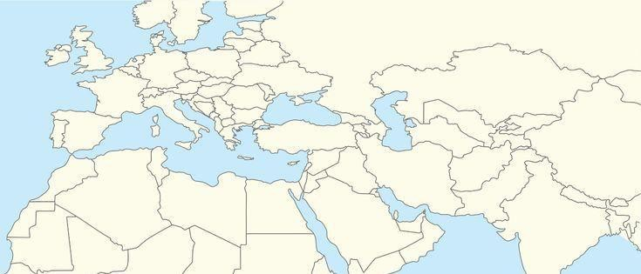
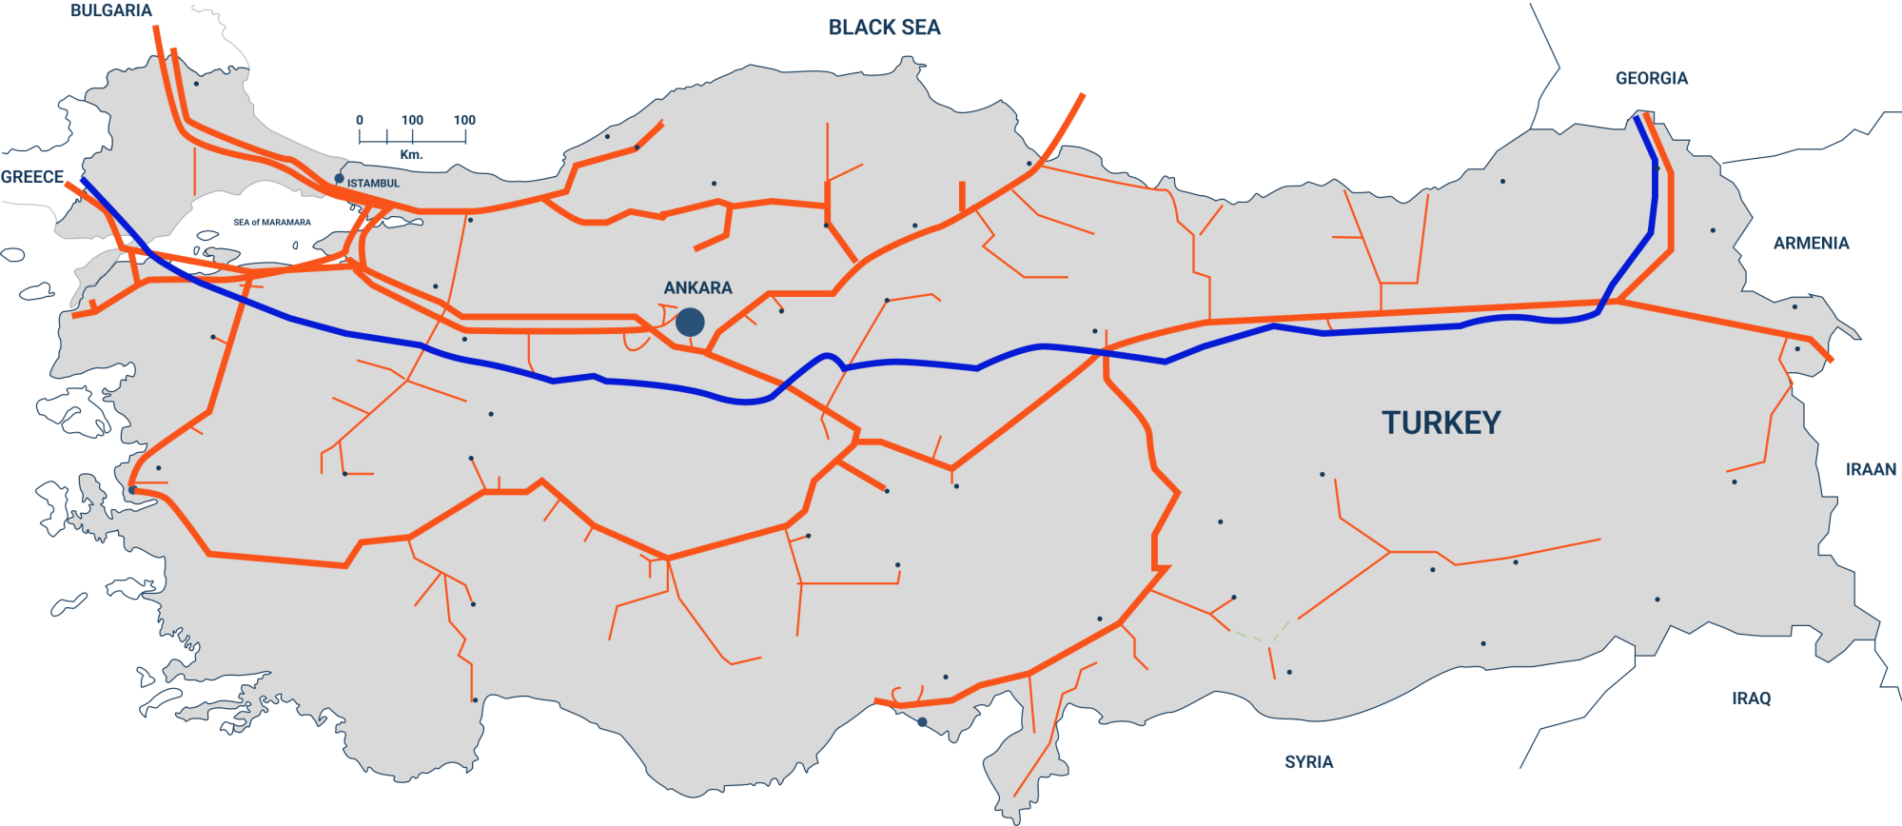

Turkiye Advantage
Strong Prices & Demand for Natural Gas & Oil
98% Imported Nat Gas
The UK
EUROPE
USD$10MCF
(Gas Price January 2026)
92% Imported Oil
~60% of gas imports from
TURKIYE
Russia/Iran
Excellent fiscal regime:
12.5% Royalty rate
22% Corporate Tax Rate
National Natural Gas Pipeline Grid in Turkiye
SASB tied into pipeline here
New Pipeline Existing Pipeline TANAP Pipeline
7th Largest Nat Gas consumer in world - over 48 BCM/ year
6 . 0
5 . 4
5 . 7
5 . 4
5 . 0
4 . 8
4 . 7
4 . 5
4 . 9
4 . 4
4 . 7
S p o t L N G
N i g e r i a ( L N G )
A l g e r i a ( L N G )
A z e r b a i j a n I r a n
R u s s i a
4 . 0
BCF/D
3 . 0
1 8 %
16%
1 7 %
16%
1 7 %
16%
1 7 %
2 . 0
1 7 %
11%
1. 0
5 5 %
5 5 %
5 3 %
5 2 %
4 7 %
4 5 %
4 2 %
3 4 %
3 4 %
0 .0
2 0 14 2 0 15 2 0 16 2 0 17 2 0 18 2 0 19 2 0 20 2 0 2 1 2 0 22
Turkiye Import Volumes of Natural gas
*Source: S&P Capital IQ
4

Slide 5
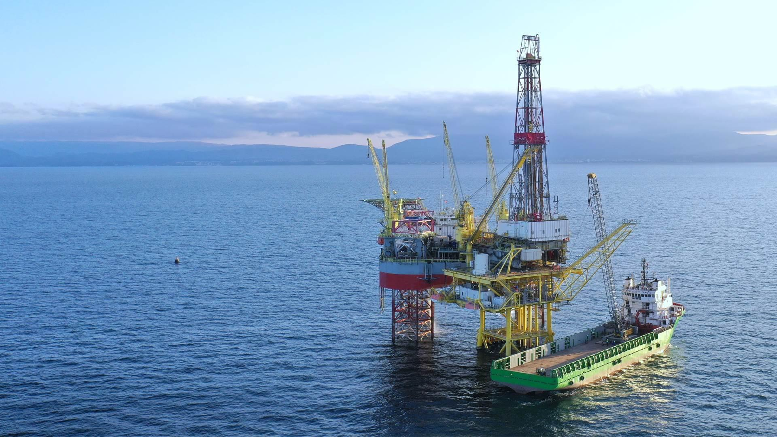

Black Sea – the new Natural Gas frontier fueling Europe
5

Slide 6
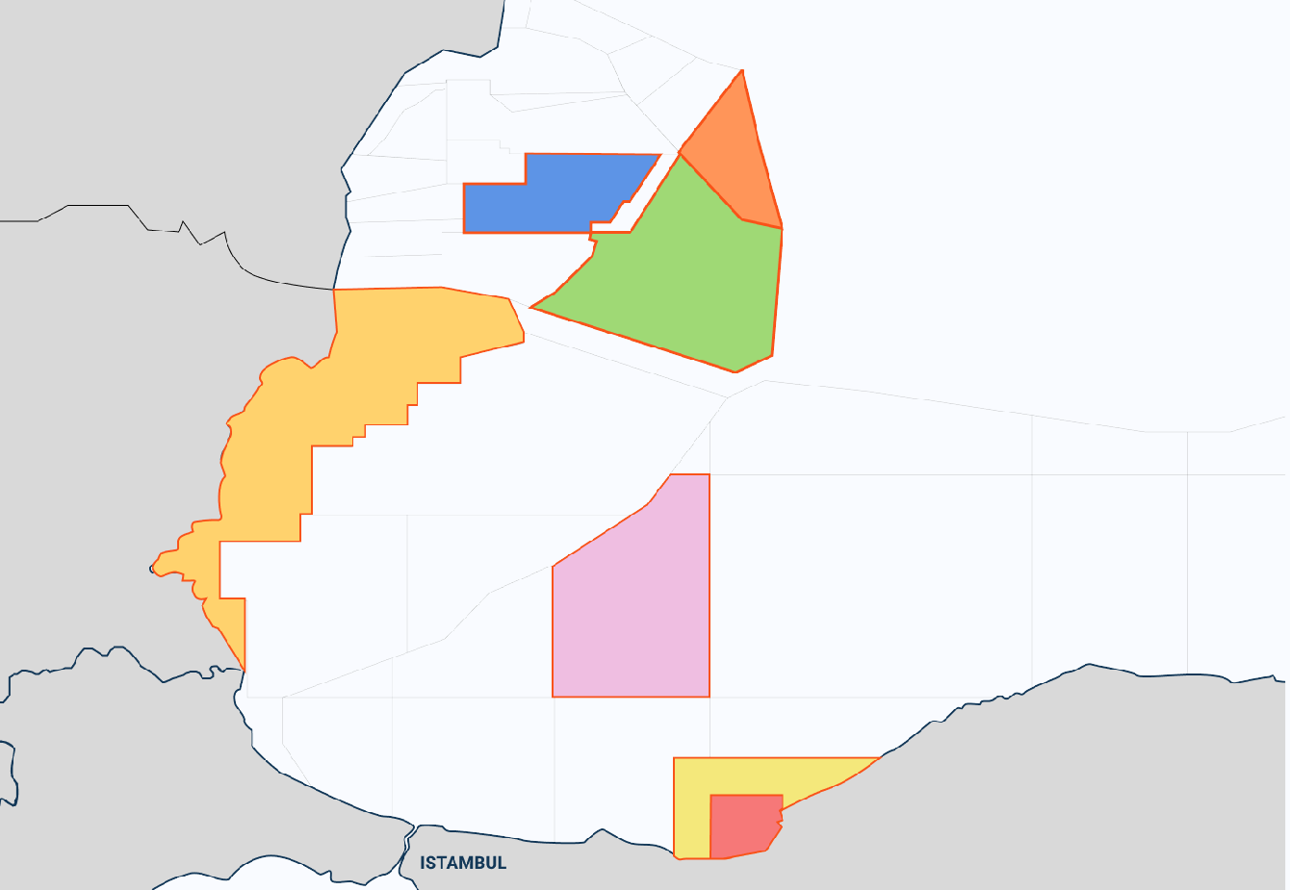
Black Sea Natural Gas Fields
DOINA
The Black Sea is a key strategic area
to regional energy future
ANA
Reserves: 56 BCF⁽¹⁾
MIDIA GAS DEVELOPMENT (ROMANIA)
Owner: BSOG (70%),
Petro Ventures (20%),
Gas Plus (10%)
Reserves: 226 BCF⁽¹⁾
TRIDENT (EX-30) GAS FIELD
(ROMANIA)
Owner: LukOil (87.8%), Romgaz (12.2%)
1
2
LIRA-1X
Reserves: Est. 1 TCF⁽²⁾
DOMINO
Reserves: Est. 4 TCF⁽³⁾
ROMANIA
3
4
5
GALATA GAS FIELD
(BULGARIA)
Owner: Petroceltic (100%)
Reserves: 81 BCF⁽⁴⁾
PELICAN SOUTH
Reserves: Est. 700 – 900 BCF⁽³⁾
NEPTUN DEEP GAS FIELD (ROMANIA)
Owner:
OMV Petrom (50%), Romgaz (50%)
BULGARIA
SAKARYA
Reserves: Est. 10
- 23 TCF⁽⁶⁾
BLACK SEA
Source: www.blackseaog.com
Source:
https://www.lukoil.com/PressCenter/Pressreleases/Pressrelease?rid=508
64
Source: S&P Global: Commodity Insights - E&P activity in the Romanian
and Bulgarian waters of the Black Sea, Oct. 2017.
Source: https://www.offshore-technology.com/projects/galata-field/
Source: Trillion Energy GLJ Report, Reserves and Prospective Resources
(Risked)
Source: https://www.reuters.com/business/energy/turkeys-natural-gas-
found-black-sea-now-comes-710-bcm-erdogan-2022-12-26/
6
SAKARYA GAS FIELD (TURKEY)
Owner: TPAO (100%)
SASB GAS FIELD (TURKEY)
Owner: Trillion Energy (49%), TPAO (51%)
OGIP: 323.3 BCF⁽⁵⁾
TURKEY
6

Slide 7
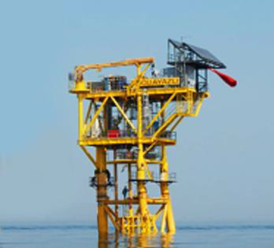
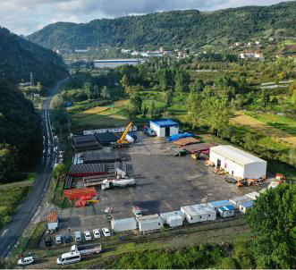
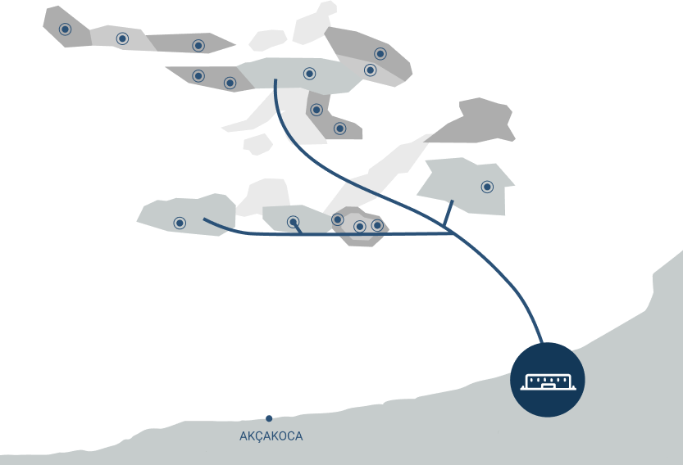

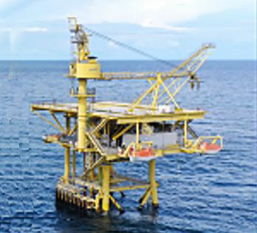
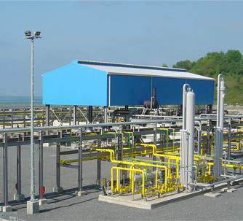

SASB Infrastructure – Solid platform for future growth
Offshore platforms
@SASB Gas Field, Black Sea
4 offshore production
platform & tripods
Shore Base
Drilling radius reachable from existing platforms
~ 3km
Onshore Gas Processing Facility
18km subsea pipeline +
onshore pipeline
Onshore Gas Processing Facility rated 75MMcf/day, expandable to 150MMcf/day
Processing facility tied into
national Natural Gas pipeline grid
US $600m+ invested into historical wells & infrastructure
12,387 Hectare development lease valid until 2031 extendable to 2041
7

Slide 8

Solid Reserves Growth
Net Reserves Summary and Net Present Value*
Strong Reserves Growth
 | Conventional |  | NPV – 10%
 | Natural gas (Bcf) |  | Before Income Tax (US$M)
 | Dec 31 ‘24 | Dec 31 ‘23 | Dec 31 ‘24 | Dec 31 ‘23
Proved
Producing | 0.0 | 1.3 | $3.4 | $11.5
Developed Non-Producing | 10.0 | 8.4 | $66.8 | $81.9
Undeveloped | 9.5 | 8.3 | $36.6 | $40.9
Total Proved | 19.5 | 18.0 | $106.8 | $134.3
Total Probable | 42.8 | 37.8 | $256.8 | $286.2
Total Proved + Probable | 62.3 | 55.8 | $363.6 | $420.5
Total Possible | 46.3 | 40.8 | $266.5 | $292.2
Total PPP | 108.6 | 96.6 | $630.1 | $712.7
PPP 108.6
PPP
96.6
PPP
73.7
PP 62.3
55.8
PP
42.5
P 18.0
P 19.5
P 10.1
2022 2023 2024
P – total proved reserves
(producing, developed non-producing and undeveloped)
PP – total proved and probable reserves
PPP – total proved, probable and possible reserves
*See Appendix for Glossary of Oil and gas terms. All figures presented in accordance with COGEH standards. Reserves and resources represent Trillion’s 49% interest at SASB conventional natural gas resources. *See Trillion’s Form 51-101F1 effective December 31, 2024 for third party reserve estimates. ** NPV 10 values assumes pricing as at December 31, 2024,. *** Future work programs include unrisked prospective resources and which are management estimates based on preliminary seismic data which is being reprocessed this year.
Recovery factor used ranges between 57-70%.
8

Slide 9
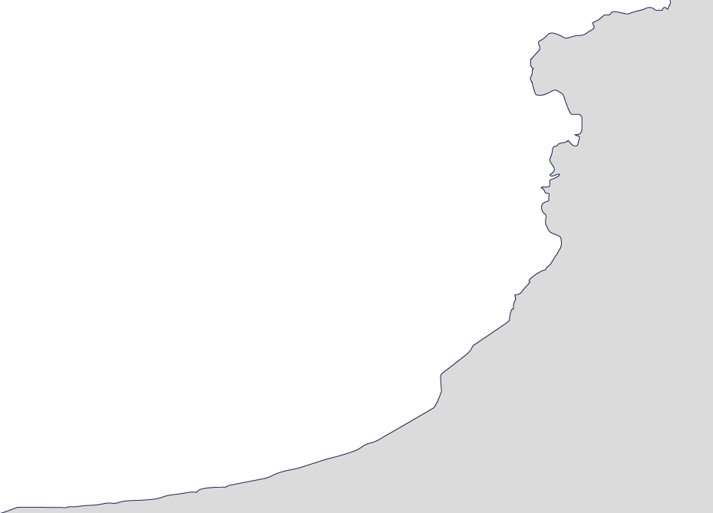


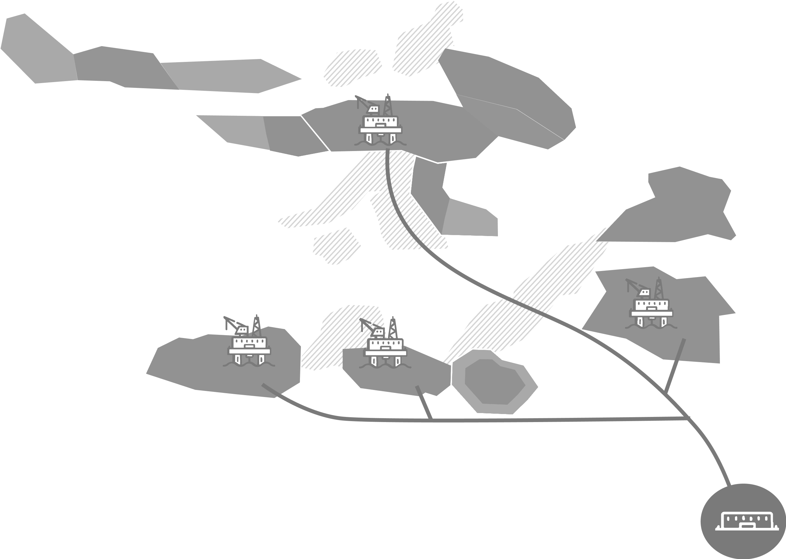





















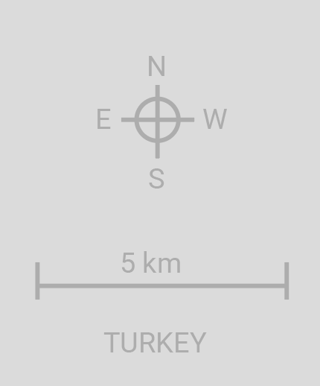












SASB Production Ramp Up 17+Wells
BLACK SEA
West Akcakoca
Tested 5.9 MMCF/D
Akcakoca-3
Tested 7 MMCF/D
Guluc – 2 Well
Tested 16.35 MMCF/D
Production Platform
Future Drilling Locations
2022-2023 Drilled locations 2026 Future Drilling Locations
Guluc Gas Field
Eskikale Gas Field
South Akcakoca Gas Field
Akcakoca Gas Field
Alapli Gas Field
SA-2 Well
Alapli - 2 Well
Completed July ‘23
Tested 7-8 MMCF/D
Channel sands prospects
Akkaya Gas Field
Ayazli Gas Field
East Ayazli Gas Field
18 km of subsea pipeline installed
Bayhanli Gas Field
Bayhanli – 2 Well
Tested 11.9 MMCF/D
Cayagzi Onshore Gas Processing Facility
9

Slide 10
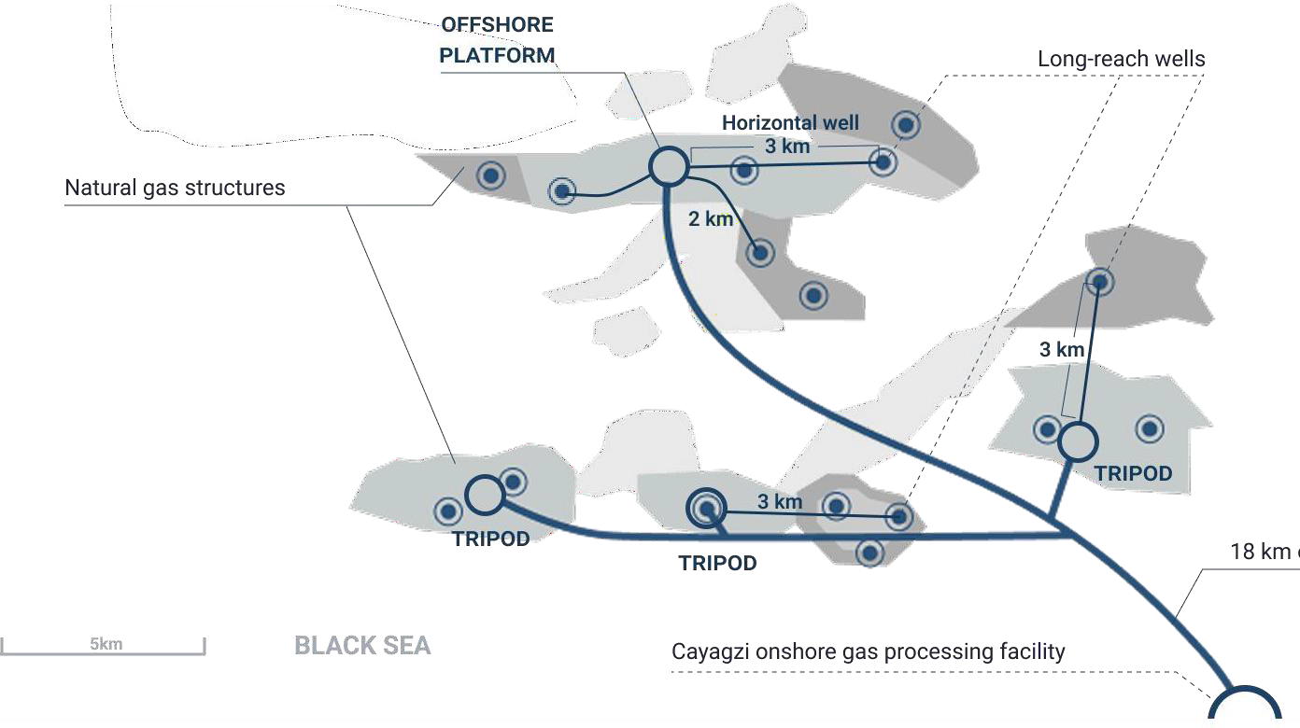

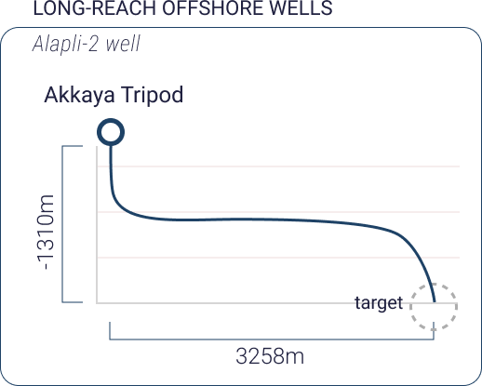
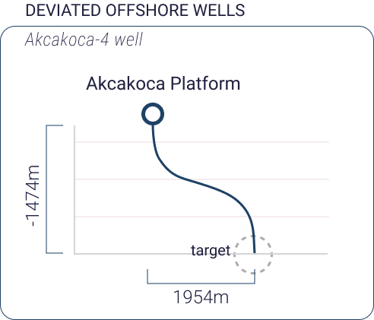
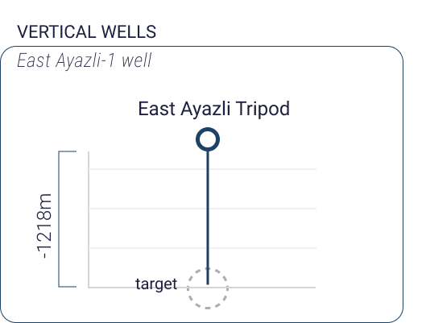

Technical Capabilities
Trillion is an experienced offshore operator
SASB GAS development offshore map
Offshore snubbing rigless workovers and
recompletions
Up to 3km drilling distance from platform to
structure
6 new long-reach wells opened new pay zones 3km from platforms
11

Slide 11
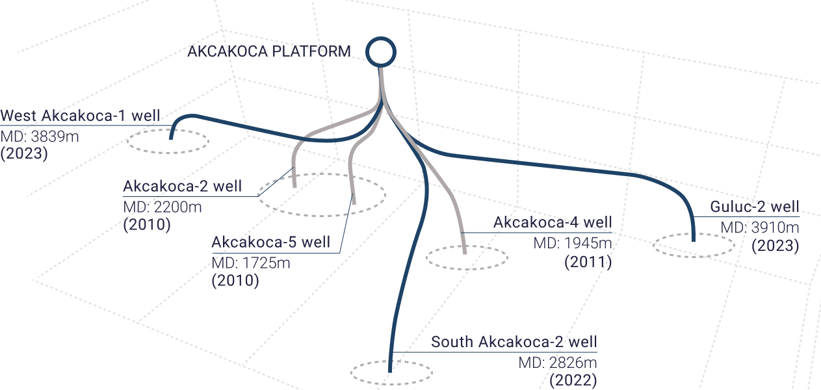
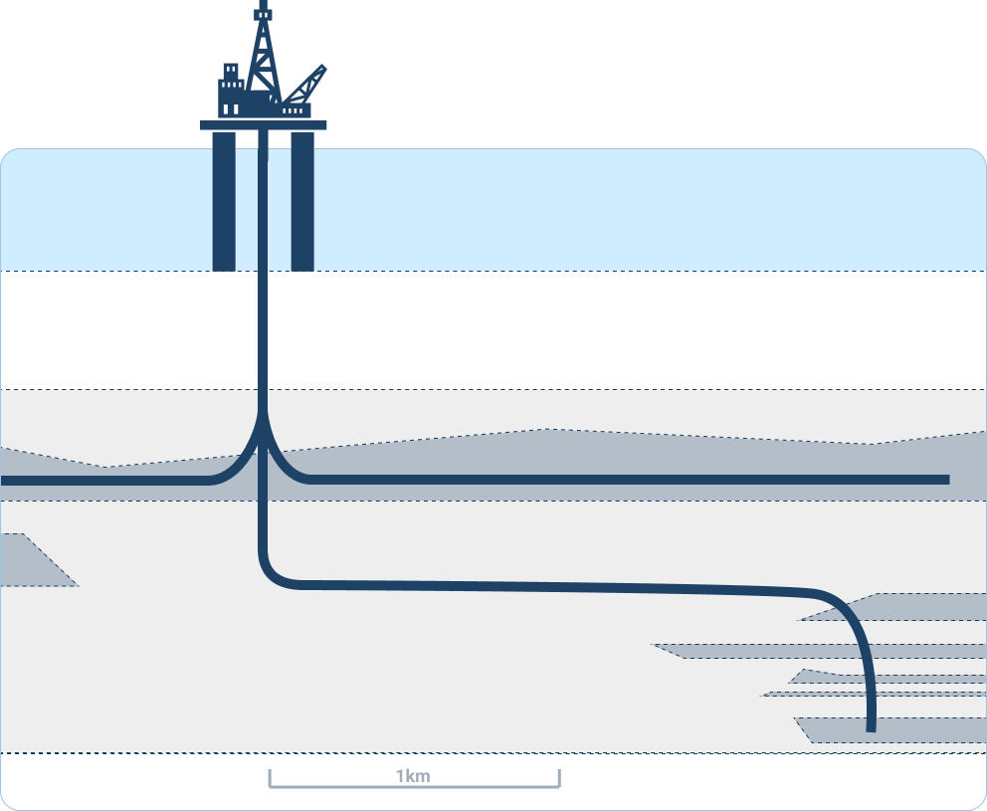

Technical Capabilities
Trillion is an experienced offshore operator
Trillion’s Akcakoca Platform (3D view)
Advanced multi-lateral drilling for enhanced production in mature offshore fields
Offshore artificial lift (gas lift and pumps) in highly deviated wells (S/J shaped)
Offshore platform
Shallow water
Directional Drilling accesses new stranded reservoirs
Multilateral Horizontal Completion Wells
up to 3km from the platform for oil and gas pay
“S” Shaped Wells
used to access stacked pay out of reach from platform
12

Slide 12

Corporate Summary
CSE: TCF | Frankfurt: Z620
| OTCQB: TRLEF
SASB
SASB Gas Field Highlights
Multi-well natural gas development program
US$410m NPV10 proved probable reserves
57 BCF proved probable reserves
Selling gas into worlds 6th largest market that is 90% dependent on imports
New Sidetrack Wells planned for
2025-2027
1BCF/month Rapid Production Ramp-up Planned by 2028
7 MMCF/d
Offshore snubbing rigless workovers and
recompletions
5 MMCF/d
Up to 3km drilling distance from platform to structure
Q2 ‘26
Q4 ’26+
13

Slide 13
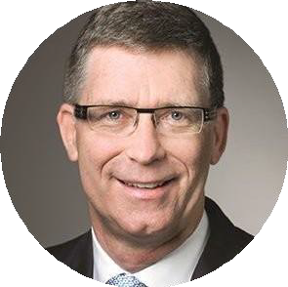
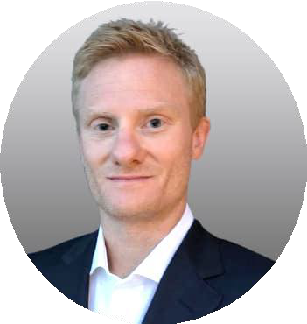
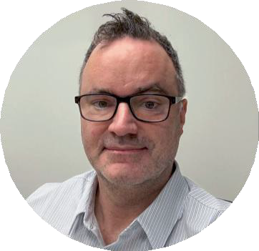
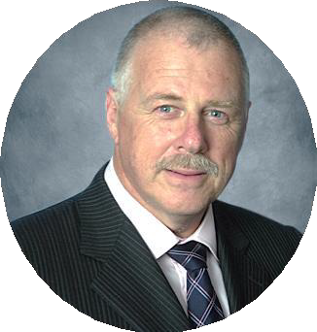
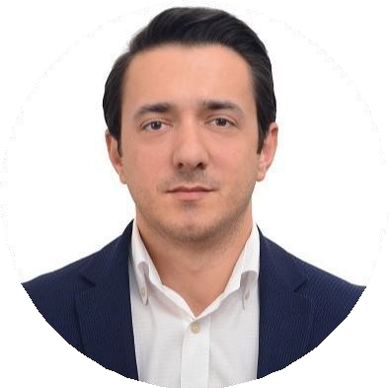
Directors & Management Team
Jay Park, KC
DIRECTOR
Sean Stofer
Mr. Park is a renowned energy lawyer with a particular focus on upstream oil and gas transactions. He has worked on energy projects in more than fifty countries, including Turkey. He has advised international energy companies, including oil and gas explorers, producers, marketers, pipeline companies, state oil companies, governments, banks and multilateral agencies such as the World Bank. Mr. Park was formerly CEO and then Chairman of ReconAfrica exploring for oil & gas in Namibia and Botswana. During this period ReconAfrica was twice named to the TSX Venture 50 and was the top performing 2021 TSX Venture 50 company from the energy sector. Mr. Park is currently Executive Chairman of MCF Energy Ltd. exploring for gas in Europe.
INTERIM CEO & CHAIRMAN
Sean Stofer has over 20 years of renewable energy experience. Mr. Stofer is a graduate of the University of British Columbia in Engineering and is a registered Engineer in California. He is a founder of several successful renewable energy companies including for the arctic’s largest solar array; 250 MW of solar in the USA; 200+MW of wind projects and over 300MW of hydroelectric projects. He is COO of Green Data Center Real Estate, which uses renewable energy to power data centers. Sean is leading a project of over 500 MW using wind, solar and hydropower. Sean has worked closely with Government to guide policy and has consulted to a wide range of companies. Sean was awarded the Top 40 Under 40 in Vancouver, Canada for his business achievements.
Scott Lower CPA
PRESIDENT
Mr. Lower has served in a consulting role for the Company for several years primarily in the public markets space and was recently appointed as President of one of the Company’s subsidiaries, Park Place Energy. Mr. Lower holds his CPA designation, a Bachelors of Business Administration from SFU and has a background in finance and public markets.
David Thompson
DIRECTOR, AUDIT COMMITTEE CHAIR
Burak Tolga Terzi
VICE PRESIDENT & DGM
Mr. Thompson has 30 years of financial experience in the oil and gas industry. He successfully founded an oil trading company in Bermuda, with offices in the U.S. and Europe, and was responsible for the company’s Turkmenistan production operations in the Lhamov and Zhdanoy oil fields (offshore Caspian Sea — part of the Turkmenistan project), which discovered producing reserves of 365M barrels oil and 2 TCF gas and successfully raised over
$100M in equity. He is Managing Director of AMS Limited, a Bermuda based Management Company. He has served as Founder, President and CEO of Sea Dragon Energy Inc. (London exchange: SDX 21.00 GBP), Financial Director of Forum Energy Plc (AIM) and SVP at Larmag Group of Companies. Mr.
Thompson is a Certified Management Accountant since 1998.
Mr. Terzi holds a Bachelor of Business Administration and Master’s degree in Business Administration and has over 17 years of experience in various management positions. Mr. Terzi previously worked for companies such as Valeura Energy Inc. (TSX: VLE) in Turkey, Weatherford International, SOCAR AQS (the State Oil Company of Azerbaijan Republic), in various roles. With extensive experience in the oil and gas industry, Mr. Terzi has held various roles across multiple companies, gaining comprehensive expertise in both commercial and technical aspects of the business. He has successfully managed and contributed to deep and shallow onshore and offshore drilling projects and underground gas storage projects, demonstrating a strong understanding of their operational and financial components.
Additionally, Mr. Terzi has valuable experience in navigating complex challenges while ensuring cost-
effective solutions and efficient execution.
14

Slide 14
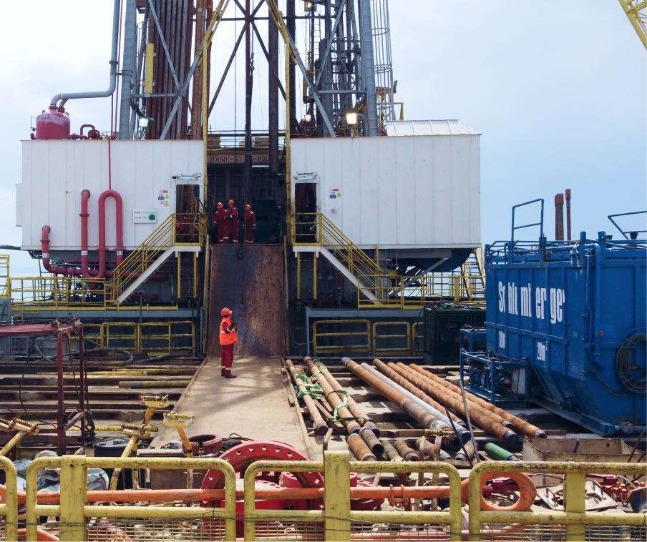

Contact
General Inquiries
info@trillionenergy.com
trillionenergy.com
Canada (Head Office)
Suite 700
838 West Hasting Street
Vancouver, BC V6C 0A6
Turkiye (Operations)
Oran Mah. Kudus Cad. 1/21 Park Oran Ofis
Plaza, No:45, Kat:14, 06450,
Cankaya, Ankara, Turkiye
15

Slide 15
Appendix
Presentation of Oil & Gas Information
Presentation of Oil & Gas Information
BOEs have been converted on the basis of six thousand cubic feet (“Mcf”) natural
gas to 1 barrel of oil. BOEs may be misleading, particularly if used in isolation. A
BOE conversion ratio of 6 Mcf: 1 bbl is based on an energy equivalency
conversion method primarily applicable at the burner tip and does not represent a value equivalency at the wellhead. In addition, given that the value ratio based on the current price of oil as compared with natural gas is significantly different from the energy equivalent of six to one, utilizing a BOE conversion ratio of 6 Mcf: 1bbl would be misleading as an indication of value
related substances anticipated to be recoverable from known accumulations, as of a given date, based on: (a) analysis of drilling, geological, geophysical and engineering data; (b) use of established technology; and (c) specified economic conditions, which are generally accepted as being reasonable. Reserves are classified according to degree of certainty associated with estimates.
“undeveloped reserves” are those reserves expected to be recovered from known accumulations where a significant expenditure (e.g., when compared to the cost of drilling a well) is required to render them capable of production. They must fully meet the requirements of the reserves category (proved, probable, possible) to which they are assigned.
Certain terms used in this presentation but not defined are defined in NI 51-101, CSA Staff Notice 51-324 - Revised Glossary to NI 51-101 Standards of Disclosure for Oil and Gas Activities (“CSA Staff Notice 51-324”) and/or the COGEH and,
unless the context otherwise requires, shall have the same meanings herein as
in NI 51-101, CSA Staff Notice 51-324 and the COGEH, as the case may be.
Oil & Gas Non-GAAP Terms.
Operating netback: Oil and gas sales less operating and transportation expenses. Operating netback per boe as presented is defined as oil and gas sales price less forecasts of transportation and quality discount, royalties, operating costs and pipeline transportation from the Brent oil price forecast.
Funds flow from operations: is defined as net income or loss adjusted for DD&A expenses, asset impairment, goodwill impairment, deferred tax expense or recovery, stock-based compensation expense, amortization of debt issuance costs, non-cash lease expense, lease payments, unrealized foreign exchange gains or losses, financial instruments gains or losses, other non-cash losses, cash settlement of financial instruments and other gains or losses.
EBITDA and Adjusted EBITDA: Net income adjusted for DD&A expenses, interest expense and income tax expense or recovery (“EBITDA”) and adjusted EBITDA, as presented, is defined as EBITDA adjusted for non-cash lease expense, lease payments, unrealized foreign exchange gain or loss, stock-based compensation expense or recovery, unrealized derivative instruments gain or loss, gain on re-
purchase of Senior Notes, other financial instruments gain or loss and other loss. Free cash flow (FCF): GAAP "net cash provided by operating activities" less projected capital spending. Management believes that free cash flow is a useful supplemental measure for management and investors to in order to evaluate the financial sustainability of the Company's business.
Net Debt: Comprised of cash and senior notes (gross).
Finding and development costs (F&D Costs): F&D costs are calculated as
estimated exploration and development capital expenditures, excluding
acquisitions and dispositions, divided by the applicable reserves additions both before and after changes in FDC costs. The calculation of F&D costs incorporates the change in FDC required to bring reserves into production.
Definitions
In this presentation:
“2P” are 1P reserves plus probable reserves.
“3P” are 1Pplus 2P plus possible reserves.
“developed producing reserves” are those reserves that are expected to be recovered from completion intervals open at the time of the estimate. These reserves may be currently producing or, if shut-in, they must have previously been on production, and the date of resumption of production must be known with reasonable certainty.
“GAAP” means generally accepted accounting principles in the Unites States
of America.
“NPV” means net present value.
“NPV10” means NPV discounted at 10%.
“possible reserves” are those additional reserves that are less certain to be
recovered than probable reserves. There is a 10% probability that quantities
actually recovered will equal or exceed sum of proved plus probable plus
possible reserves. Possible reserves may be developed or undeveloped.
“probable reserves” are those unproved reserves that are less certain to be recovered than proved reserves. It is equally likely that actual remaining quantities recovered will be greater or less than sum of estimated proved plus
probable reserves. Probable reserves may be developed or undeveloped.
“proved developed reserves” or “PDP” are those proved reserves that are
Reserves Information
Unless otherwise expressly stated, all reserves values, future net revenue,
ancillary information and any measure of oil and gas activities contained in this
presentation is as at January 31, 2023 and has been prepared and calculated in
accordance with Canadian National Instrument 51-101 – Standards of Disclosure for Oil and Gas Activities (“NI 51-101”) and the Canadian Oil and Gas Evaluation Handbook (“COGEH”) and derived from a report with an effective date of January 31, 2023 prepared by GLJ Ltd. (“GLJ”), Trillion’s independent qualified reserves evaluator and auditor (the “GLJ Report”). Any reserves estimate or related information contained in this presentation as of a date other than January 31, 2023 has an effective date of January 31 of the applicable year and is derived from a report prepared by Trillion’s independent qualified reserves evaluator and auditor as of such date, and additional information regarding such estimate or information can be found in Trillion’s applicable Statement of Reserves Data and Other Oil and Gas Information on Form 51-101F1 filed on SEDAR at www.sedar.com.
These non-GAAP measures do not have a standardized meaning under GAAP.
Investors are cautioned that these
measures should not be construed as an alternative to net income or loss or other
measures of financial performance
as determined in accordance with GAAP. Gran Tierra's method of calculating
these measures may differ from other
companies and, accordingly, it may not be comparable to similar measures used
by other companies. These non-GAAP financial measures are presented along with the corresponding GAAP measure so as to not imply that more
emphasis should be placed on the non-GAAP measure.
expected to be recovered from existing wells and installed facilities or, if facilities have not been installed, that would involve a low expenditure (e.g., when compared to cost of drilling a well) to put reserves on production. Developed category may be subdivided into producing and non-producing.
“proved reserves” or “1P” are those reserves that can be estimated with a high degree of certainty to be recoverable. It is likely that actual remaining quantities recovered will exceed estimated proved reserves.
“reserves” are estimated remaining quantities of oil and natural gas and
Estimates of reserves provided in this presentation are estimates only and there is no guarantee that estimated reserves will be recovered. Actual reserves may be greater than or less than estimates provided in this presentation and differences may be material.
16

